Slide 1
Innovation Idea
Smarter Analytics for Car Buying Experiences
Idea Proposal for Marketplace
Senior Management Meeting July 19th 2011
Dr. Sebastian Wedeniwski (IBM) Idea Owner
Peter Schneider (ITA) Management-Scout
Version 1.0 (Final)
Smarter Analytics for Car Buying Experiences - Dr. Sebastian Wedeniwski

Slide 2
Agenda
1 |  | Management Summary
2 |  | Why do we need the Idea?
3 |  | Idea Description
4 |  | Why innovative ?
5 |  | Business Benefit
6 |  | Cost Calculation
7 |  | Potential risk
8
9
10
11
12
Smarter Analytics for Car Buying Experiences - Dr. Sebastian Wedeniwski
SMM July 19th, 2011

Slide 3
1. Management Summary:
Brief Overview
Issue. The current Mercedes-Benz Used Car Portal requires knowledge of Daimler taxonomy and does not assist on buyer preferences. It provides an inflexible interface regarding specific demands of countries and buyers. Scope: Using Advanced Analytics assisting buyers to identify faster the right choices from a larger pool. Extending offerings which matches on customer interests.
Benefits / Risks / Dependencies | Deliverables (Room-3)
Business Benefits Assists buyers to identify faster the right choices from a larger pool Generates a new layer of business opportunities and value Consumer oriented and new channel to sell cars Improves relation and interactions with customers. Collect more specific information on consumer needs/interests Opportunities to include additional information, e.g. detailed life-cycle information Innovation A personalized electronic assistant for potential buyers. Risks Daimler business units want a 100% mapping of buying preferences on extended profiles of products Expectation of potential buyers might not always be mapped on unique buying preferences Daimler After Sales or Marketing will not support the idea | Detailed Calculation of Business Case Qualified Business Benefits Develop pilot App and functional test Specify Mercedes dictionary and categories for ontology, e.g. comfort, safety Calculate first cost for Portal implementation
 | Idea Organization
 | Sebastian Wedeniwski (IBM) Idea-Owner Peter Schneider (ITA) Innovation-Scout
Project Cost | OIN Level
Internal Resources………….............: ITF, GSP Budget……………............................: 20 K € Resources TSS, Apple, IBM, SAP....: IBM | Proposal for Room-3, Marketplace
Smarter Analytics for Car Buying Experiences - Dr. Sebastian Wedeniwski
SMM July 19th, 2011

Slide 4
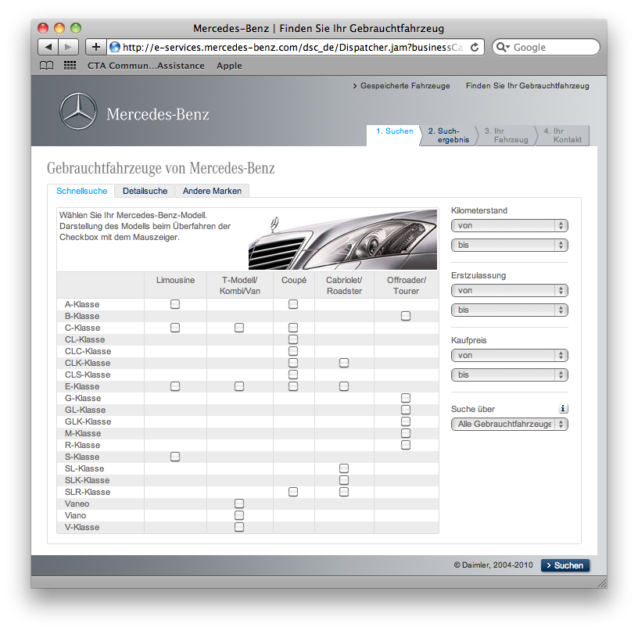
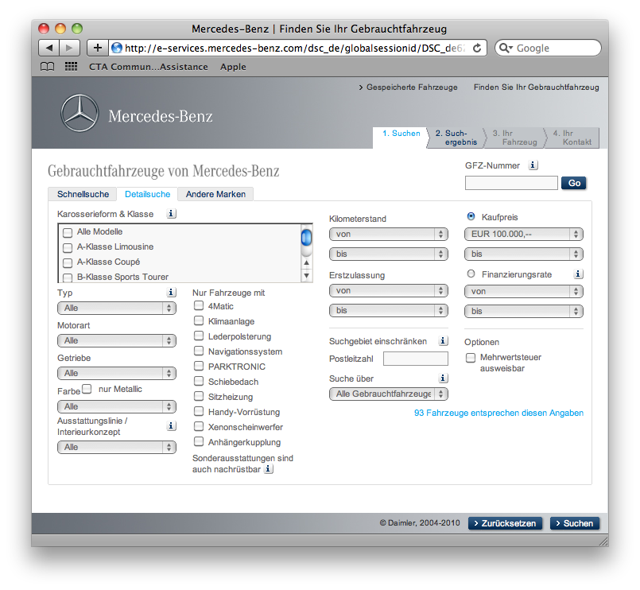
2. Why do we need Smarter Analytics for Car Buying Experiences ?
Current Mercedes-Benz Used Car Portal
A strict selection mask with only dedicated and limited selection options work for simple quantifiable characteristics, for example, an identification of a car based on price, mileage, age, fuel consumption, and other simple features.
  Requires knowledge of Daimler taxonomy
  Limits search to view filter criteria on structured data
  Inflexible interface regarding specific demands of countries and buyers
  Does not assist on buyer preferences
Smarter Analytics for Car Buying Experiences - Dr. Sebastian Wedeniwski
SMM July 19th, 2011

Slide 5
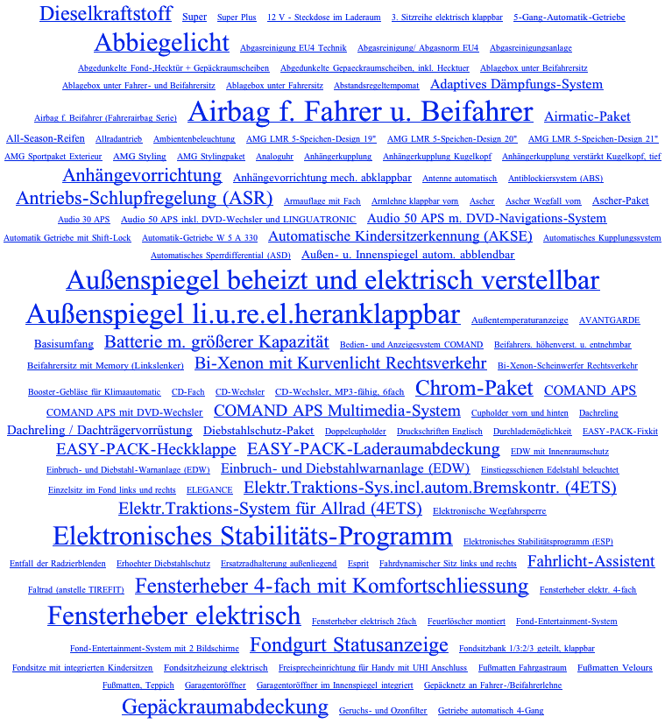
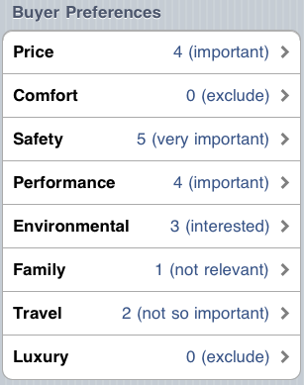
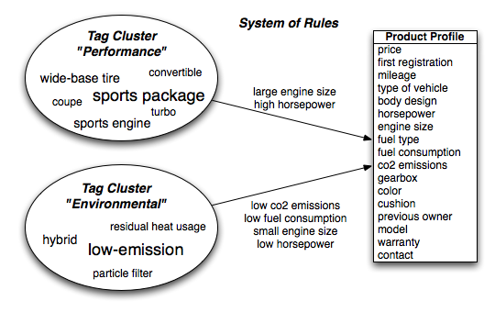
3. Idea Description:
Object Selection based on natural language queries
  Consumers have specific buying experiences and buying expectations
  Consumers do not want to be limited by predefined object characteristics and vocabulary to define their needs
  Consumers have specific, individual, qualitative preferences potentially within quantifiable characteristics
  Buying preferences are reflected in different dimensions where, for example, the definition of “safety”, “comfort”, “luxury” or “environmental” may depend at least on the product context and characteristics thereof.
Smarter Analytics for Car Buying Experiences - Dr. Sebastian Wedeniwski
SMM July 19th, 2011

Slide 6
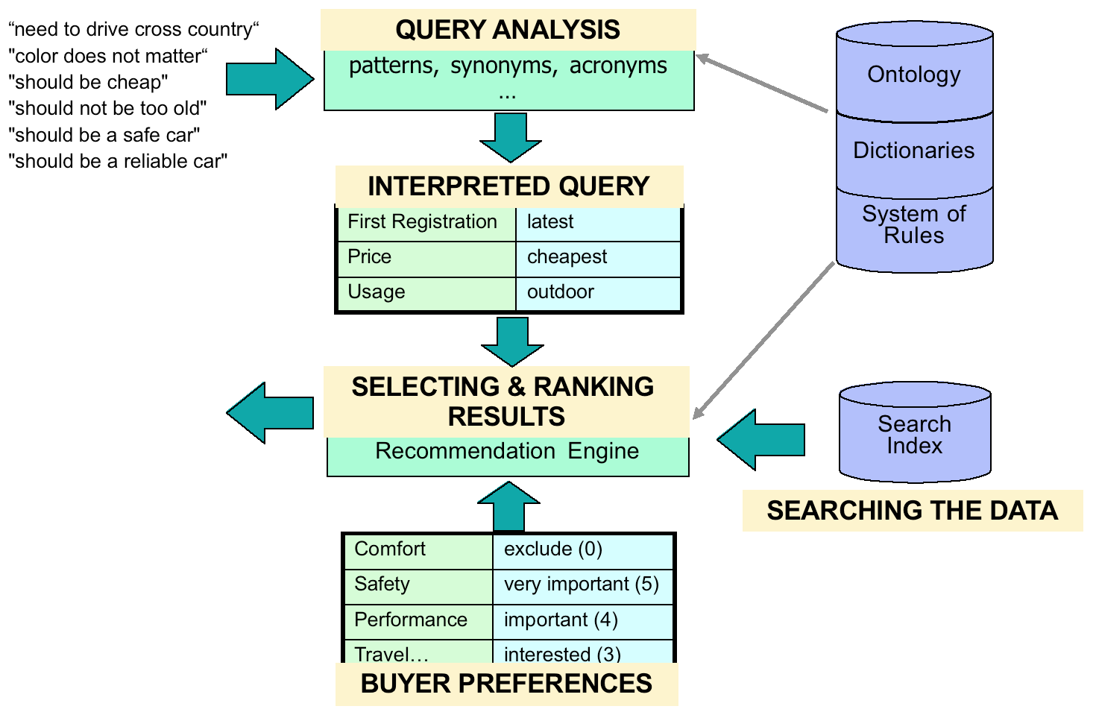
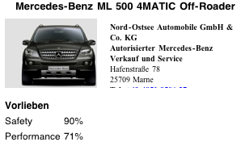

4. Why Innovative ?
  A user interface for receiving natural language input.
  A method determining a data structure of weighted keywords based on the natural language input using at least one out of the group consisting of the predefined dictionary, the predefined ontology, predefined system rules, and a predefined regular expression.
  Selecting the object out of the group of objects based on a mapping of the extended profile and the data structure of weighted keywords resulting in a preference fit score for the selected object, wherein the mapping comprises using at least one out of the group consisting of an N-Gram distance function between data elements of the extended profile and data elements of the data structure of weighted keywords, thresholds specified in the extended profile, and weights of rules.
  The selection engine comprises a receiving unit adapted for receiving object-related information indicative of properties of objects of the category by using network connected databases, and a generating unit adapted for generating an extended profile.
Smarter Analytics for Car Buying Experiences - Dr. Sebastian Wedeniwski
SMM July 19th, 2011

Slide 7
5. Business Benefit
Position | Description | Qualified Benefit | Saving 1000 €
1 | Assists buyers to identify faster the right choices from a larger pool | 95% of the search results fit better to the customer needs than the current solution | ?
2 | Opportunities to include additional information, e.g. detailed life-cycle information | More detailed information makes each offering more attractive
Smarter Analytics for Car Buying Experiences - Dr. Sebastian Wedeniwski
SMM July 19th, 2011

Slide 8
6. Cost Calculation
Position | Description | Quality of Cost Calculation | Cost 1000 €
1 | Specify Mercedes dictionary and categories for ontology, e.g. comfort, safety | rough calculation | 7
2 | Detailed Calculation of Business Case | rough calculation | 3
3 | Develop pilot App and functional test | supplier offer | 7
4 | Calculate first cost for Portal implementation | supplier offer | 2
5 | Qualified Business Benefits | rough calculation | 1
Smarter Analytics for Car Buying Experiences - Dr. Sebastian Wedeniwski
SMM July 19th, 2011

Slide 9
7. Potential Risk
Risk | Detailed Description | Implication if Risk happens | Probability (High/Med/Low)
1 | Daimler business units want a 100% mapping of buying preferences on extended profiles of products | Reduce offering on limited consumer profiles | High
2 | Expectation of potential buyers might not always be mapped on unique buying preferences | Start offering as pilot to collect experiences | Low
3 | Daimler After Sales or Marketing will not support the idea |  | Med
Smarter Analytics for Car Buying Experiences - Dr. Sebastian Wedeniwski
SMM July 19th, 2011

